Slide 1

DISSERTATION DEFENSE
Movement and Control of
Biomimetic Humanoid Robots
Ben P. Bolen
Mechanical Engineering PhD defense
Advisor: M. Anthony Hunt, Ph.D.
November 6, 2026
Portland State University · Agile & Adaptive Robotics Laboratory
01
Notes:
Opening, 30 seconds. This dissertation develops and tests components needed to study a biomimetic robot under neural control. It establishes actuator and joint results and selected simulation capabilities. It does not demonstrate harness-free walking. Advisor: M. Anthony Hunt.
Sources: Portland State University · Agile & Adaptive Robotics Laboratory

Slide 2
THE ARGUMENT
Four gaps connect actuator mechanics to neural-control experiments
Knowledge gap | Contribution tested here
Force across actuator lengths | Resting-length-aware force model
Torque through compliant routes | Identified corrections and redesigned-route tests
Scattered sensory evidence | Linked, searchable SADb resource
Untested model connections | Interfaces with matched circuit checks
Revision C · Ch. 1, research gaps and objectives
02
Notes:
Allow 1 minute. Read the argument in chapter order: predict force across actuator lengths; predict the torque delivered through compliant routes; recover source-grounded sensory evidence; and connect neural circuits to mechanical models with representative verification. These are project-specific gaps, not claims that no related tools exist elsewhere. A research robot is the long-term goal. Each contribution needs its own evidence.
Sources: Revision C · Ch. 1, research gaps and objectives

Slide 3

SCOPE AND ATTRIBUTION
This dissertation adds models and tests to an existing robot program
Existing anatomy and mechanisms
New route modeling and tests
Revision C · Ch. 1; Ch. 6, Model Conversion and Actuator Coupling
03
Notes:
1 minute. Credit the AARL body plan, Morrow’s earlier robot and the Li walker mechanics, Steele’s biomimetic knee, and Deng’s published controller. OpenSim supplies human anatomy and targets; MyoConverter supplies initial conversion; MuJoCo supplies physics; SNS-Toolbox supplies neuron and synapse formulations. My contributions include actuator characterization with collaborators, correction identification, route-design and testing work with collaborators, SADb curation and application, model repairs and audits, and graphical circuit/interface implementations. The 92-actuator model is a modeling scope, not a physical robot completed in this dissertation. Ask me to explain the specific change and evidence rather than implying I invented these packages.
Sources: Revision C · Ch. 1; Ch. 6, Model Conversion and Actuator Coupling

Slide 4

ACTUATOR CHARACTERIZATION
Isometric tests measured force across length, pressure, and contraction
10 mm and 20 mm actuators; 537 observations
Bolen, Elzein, Pang, and Hunt (2026), Actuators · Revision C, Ch. 3
04
Notes:
1 minute. Introduce a braided pneumatic actuator (BPA). Characterization used 10 mm and 20 mm Festo actuators, up to 620 kPa, with 537 force-pressure-contraction observations: 321 for 10 mm and 216 for 20 mm. Resting lengths: 112–518 mm for 10 mm, 300–509 mm for 20 mm. These are isometric measurements. Credit collaborators as coauthors. Valve dynamics and hysteresis are outside this static model.
Sources: Bolen, Elzein, Pang, and Hunt (2026), Actuators · Revision C, Ch. 3

Slide 5


ACTUATOR RESULT
Maximum isometric force decreases as resting length becomes shorter
Bolen et al. (2026), Actuators · Revision C, Fig. Fmax_fit
05
Notes:
1 minute. These existing MATLAB plots retain the experimental data and model curves. Explain the x-axis as resting length and the y-axis as force at 620 kPa. Filled points are experimental data, the solid line is the new fit, and the dashed manufacturer curve differs most for short actuators. Avoid a universal novelty claim beyond the published scope.
Sources: Bolen et al. (2026), Actuators · Revision C, Fig. Fmax_fit

Slide 6
ACTUATOR RESULT
At 112 mm, the new model reduces force error from 42.1% to 4.5%
350.9 N measured
Revision C · Ch. 3, Effects of Resting Length; 10 mm BPA at 620 kPa
06
Notes:
1 minute. This is one specific measured case, not an average error or an independent holdout claim. Measured force 350.9 N, new model 335.3 N, manufacturer tool 498.6 N. Errors quoted verbatim from Chapter 3. The chart is a native editable chart reconstructed from the reported numeric values, not digitized from an image.
Sources: Revision C · Ch. 3, Effects of Resting Length; 10 mm BPA at 620 kPa

Slide 7


ACTUATOR MODEL
Normalized force curves describe both tested actuator diameters
Bolen et al. (2026), Actuators · Revision C, Fig. GenForceFit
07
Notes:
1 minute. Define dimensionless force, pressure, and contraction verbally. Each diameter has its own fitted coefficients. The complete 537-point set is not shown in these representative isoclines. The source used an 80/20 training/validation split. A random point split does not establish generalization to every new actuator or dynamic condition. The force model also requires each actuator’s measured maximum contraction.
Sources: Bolen et al. (2026), Actuators · Revision C, Fig. GenForceFit

Slide 8
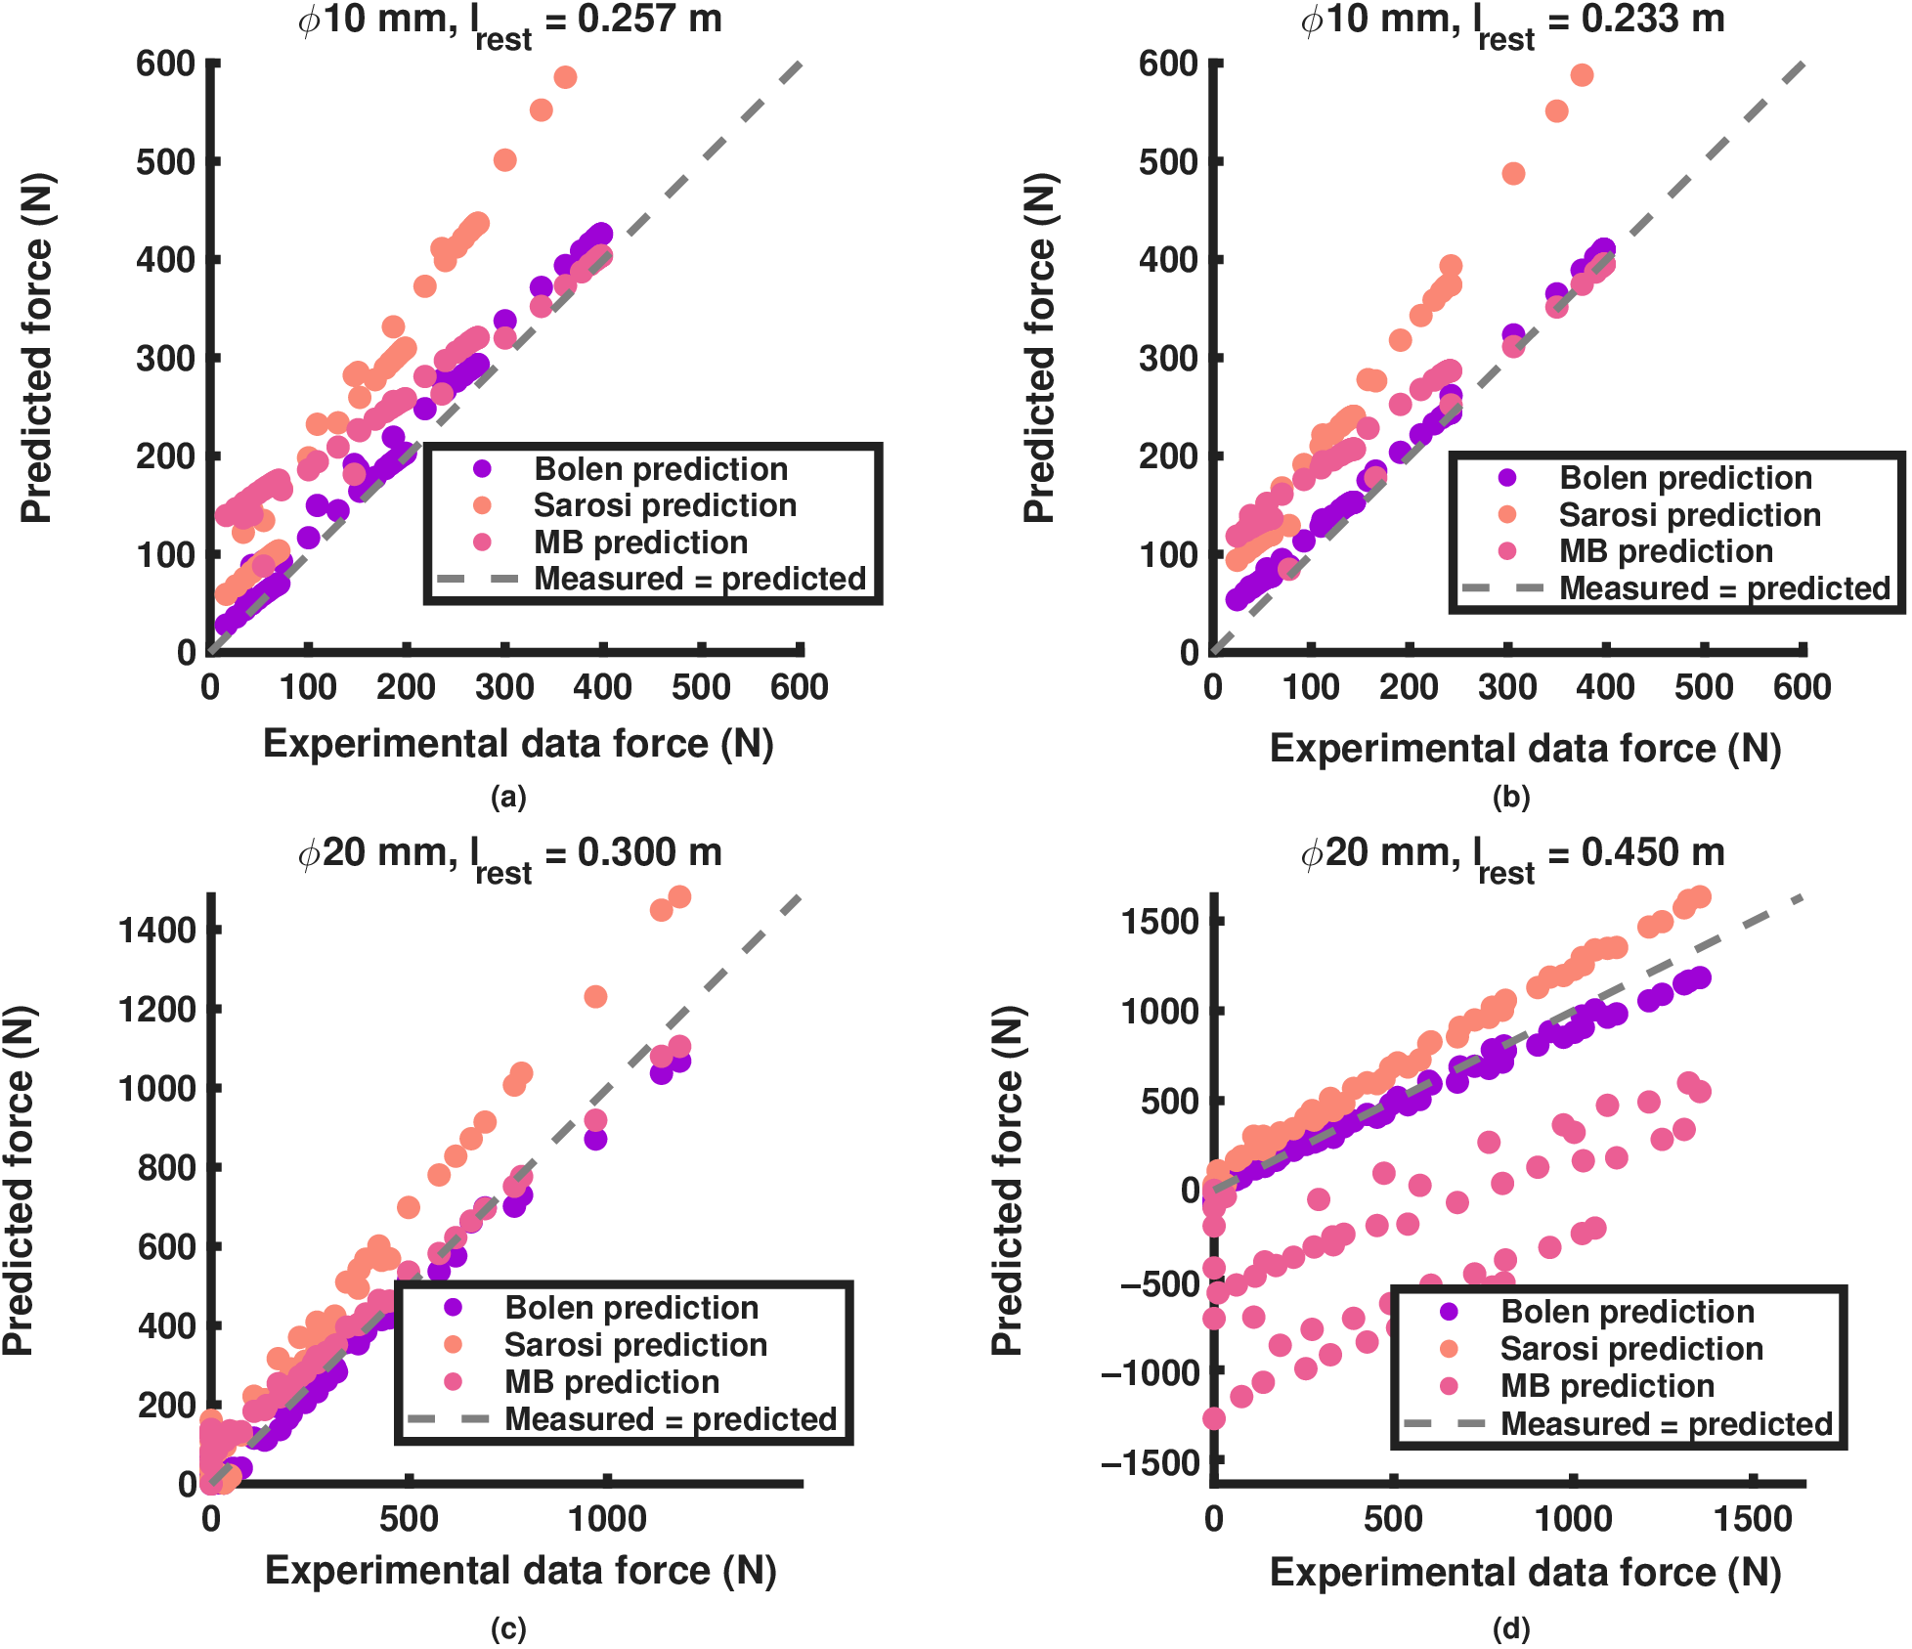
ACTUATOR EVIDENCE
The new model has the lowest error in the reported model comparisons
Bolen et al. (2026), Actuators · Revision C, Fig. Comparison and model-comparison table
08
Notes:
1 minute. Explain the measured-versus-predicted axes and diagonal. Four matched diameter/length cases compare this model with Sárosi and Martens–Boblan predictions. Scope the assertion to these reported comparisons. Do not imply exhaustive superiority over every BPA model. Complete statistics and coefficients remain in the dissertation. This ends the actuator section: a force prediction still needs a transmission model before it predicts joint torque.
Sources: Bolen et al. (2026), Actuators · Revision C, Fig. Comparison and model-comparison table

Slide 9

JOINT TORQUE: EXPERIMENTAL DESIGN
Pinned and biomimetic knees separate identification from transfer tests
Revision C · Ch. 4, test stands; four-bar knee credited to Steele et al.
09
Notes:
1 minute. The pinned knee supports identifying transmission effects. The biomimetic four-bar knee has a moving instantaneous center, so load-cell forces must be transformed to that center. Separate force characterization, correction identification, route optimization, and physical tests throughout this section. These apparatus views are existing figure components.
Sources: Revision C · Ch. 4, test stands; four-bar knee credited to Steele et al.

Slide 10

JOINT TORQUE: DIAGNOSIS
Measured actuator length exposes errors in the rigid-route prediction
Revision C · Ch. 4, Fig. FlxPin_preopt; hybrid-method description
10
Notes:
1 minute. The hybrid method substitutes measured actuator length into the characterized force calculation while retaining the joint mechanics. Its closer agreement with measured torque implicates transmission/length assumptions. This is diagnostic evidence, not proof that the force model has zero error. Show where the yellow hybrid points approach the blue measured points while the rigid prediction diverges.
Sources: Revision C · Ch. 4, Fig. FlxPin_preopt; hybrid-method description

Slide 11

JOINT TORQUE: MODEL CONTRIBUTION
The corrected model accounts for length offset, compliance, and wrapping
Effective system stiffness includes the fixtures and transmission
Revision C · Ch. 4, Improved Torque Model; Appendix C
11
Notes:
1 minute. Chi0 is a constant length offset. Chi1 and chi2 encode effective system stiffness, lumping brackets, fixtures, and the cable winch; they are not independently measured bracket material properties. Chi3 represents lost active length during wrapping. One stiffness pair serves the adopted flexor and extensor configurations. The flexor identification has a flat stiffness valley, so the fitted pair is not unique. The externally imposed redesign overshoot criterion helped choose the adopted pair.
Sources: Revision C · Ch. 4, Improved Torque Model; Appendix C

Slide 12
JOINT TORQUE: IDENTIFICATION
Identification reserves tests before assessing corrected predictions
Adopted fold | Training | Held out | Not used
Pinned flexor | 2 tests | 2 tests | 1 test
Pinned extensor | 3 tests | 3 tests | 3 tests
Identify corrections: gamultiobj
Redesign routes: surrogateopt, then patternsearch
Revision C · Ch. 4, Tables FlxPinGof and ExtPinGof; Appendix C
12
Notes:
1 minute. gamultiobj provides the Pareto fronts for identification. Report adopted-member fold assignments: flexor training 48.5 and 41.0 cm, validation 45.7 and 40.6 cm with tendon. The unused 47.9 cm test is a separate post hoc evaluation with encoder correction. Extensor uses three training and three validation tests; three early tests with bracket shifts are excluded. Row 77 of the flexor front and row 32 of the pair-locked extensor front are the picks of record. Route redesign later uses surrogateopt plus patternsearch, a different optimization task.
Sources: Revision C · Ch. 4, Tables FlxPinGof and ExtPinGof; Appendix C

Slide 13

JOINT TORQUE: REPRESENTATIVE EVIDENCE
The corrected flexor model reproduces the held-out torque trend
Held-out mean RMSE: 7.588 to 1.490 N·m
Revision C · Ch. 4, Fig. FlxPin_optimized; Table FlxPinGof
13
Notes:
1 minute. Left is a training test, right a validation test. The adopted full two-bracket model reduces mean RMSE from 8.656 to 1.624 N·m for training and 7.588 to 1.490 N·m for validation. RMSE means root-mean-square error. Figure traces illustrate the pattern; they do not replace per-test statistics. The historical 48.0 cm label in the source panel differs from the 48.5 cm reporting convention in the current table and must be explained if asked.
Sources: Revision C · Ch. 4, Fig. FlxPin_optimized; Table FlxPinGof

Slide 14
JOINT TORQUE: VALIDATION
Corrections reduce held-out error in both pinned-knee configurations
Held-out mean RMSE (N·m) | No corrections | Corrected
Flexor, 2 validation tests | 7.588 | 1.490
Extensor, 3 validation tests | 2.554 | 1.098
Revision C · Ch. 4, Tables FlxPinGof and ExtPinGof
14
Notes:
1 minute. Native table uses the exact reported validation means, N·m. Baseline means the characterized BPA model without transmission corrections. This table does not compare the original legacy force model. Flexor n=2 validation tests; extensor n=3. All six used extensor tests improve in RMSE, but the 43.2 cm tendon training test retains fraction of variance unexplained above one. Avoid stating every fit is uniformly good.
Sources: Revision C · Ch. 4, Tables FlxPinGof and ExtPinGof

Slide 15

JOINT TORQUE: REASON TO REDESIGN
The earlier single-actuator flexor falls short of its human target
Earlier geometry: one 20 mm actuator
Revision C · Ch. 4, Fig. FlxGrp, panel B
15
Notes:
1 minute. This is the earlier 41.5 cm single 20 mm actuator configuration, not the later 56.2 cm pair. The maximum-isometric human reference is model-derived, not a person tested on this rig. It falls short at roughly 60–100 degrees of flexion. Lower-pressure points expanded accessible motion because full-pressure loading threatened the printed femur. This motivates route redesign rather than presenting the earlier capacity as the final result.
Sources: Revision C · Ch. 4, Fig. FlxGrp, panel B

Slide 16
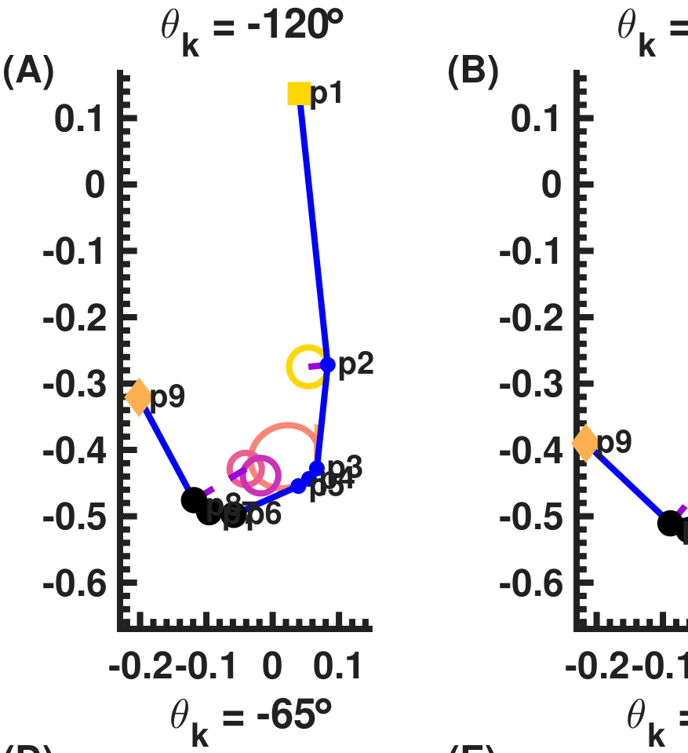
ROUTE REDESIGN: GEOMETRY AND HARDWARE
The optimized cam route became a two-actuator test assembly
Predicted route at −120°
Assembled cam-extensor hardware
Revision C · Ch. 4, Fig. ExtensorRoute_redesigned and cam-extensor hardware photograph
16
Notes:
1 minute. Route optimization changes attachment geometry under the adopted correction terms and geometric constraints. Credit Morrow’s collaboration in optimization. The cam extensor design of record uses two 20 mm BPAs. The assembly photograph establishes construction, while subsequent torque measurements establish its tested capacity. The image is a crop of existing panel A at −120 degrees; no geometry is redrawn.
Sources: Revision C · Ch. 4, Fig. ExtensorRoute_redesigned and cam-extensor hardware photograph

Slide 17

ROUTE REDESIGN: MODEL PREDICTION
The cam model predicts at least 30.83% margin over the required envelope
Prediction at 620 kPa; required envelope includes 5% overshoot
Revision C · Ch. 4, redesigned-route results; cam result of record, 14 October 2026
17
Notes:
1 minute. The required envelope is the selected vastus-medialis maximum-isometric target plus 5 percent. Minimum predicted margin: +30.83 percent over the required envelope, or +39.77 percent over the plain target. These are model predictions, not measured margins. Pressure needed to meet the required envelope is predicted at 269–507 kPa. This existing MATLAB plot uses the optimized 620 kPa curve. Distinguish it from the variable-pressure holds next.
Sources: Revision C · Ch. 4, redesigned-route results; cam result of record, 14 October 2026

Slide 18

ROUTE REDESIGN: PHYSICAL EVIDENCE
Nine cam-extensor holds test torque across −119° to +5°
Pressure varied between holds
Revision C · Ch. 4, Fig. extensor_physical_final; MATLAB Ext20mm_compare_20261022.png
18
Notes:
1.5 minutes. Blue measured points, yellow pressure-specific model predictions, pink optimized 620 kPa curve, dotted human target. Marker area indicates pressure. The test set has nine points spanning −119 to +5 degrees. Measurements meet or exceed the human-reference magnitude over most, not all, tested angles. Pressure varies between holds; this does not measure a 620 kPa envelope at every angle. Use the final MATLAB reduction in Revision C, not the earlier paper paragraph that still says the reduction is pending, and never substitute Excel sanity-check cells.
Sources: Revision C · Ch. 4, Fig. extensor_physical_final; MATLAB Ext20mm_compare_20261022.png

Slide 19
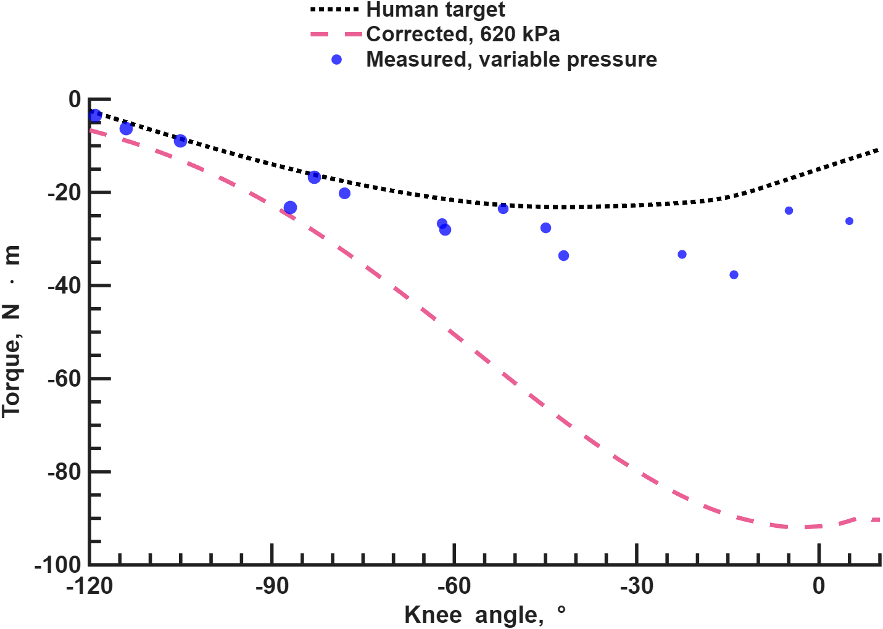
ROUTE REDESIGN: PHYSICAL EVIDENCE
All 15 flexor holds meet or exceed the human muscle target
15 holds at 226.5–638 kPa; margins +0.42 to +17.0 N·m
Knee-torque paper · Fig. Flx20mm; MATLAB generator gen_Flx20mm_3panel_20261023.m
19
Notes:
1.5 minutes. Final 23 October MATLAB reduction with measured reaction-point geometry. Two 20 mm actuators, resting length 56.2 cm. Fifteen holds from −119 to +5 degrees. Magnitude margins over the model-derived biceps femoris short-head reference range from +0.42 N·m at −105 degrees to +17.0 N·m at −14 degrees. These are discrete isometric points, not a continuous experimentally verified envelope. Recorded pressures span 226.5–638 kPa, including points above the nominal 620 kPa model curve. Model peaks and measured points must not be compared as if pressures were matched. Plot regenerated from the original numeric MATLAB source with unchanged calculation, enlarged labels, and external legend.
Sources: Knee-torque paper · Fig. Flx20mm; MATLAB generator gen_Flx20mm_3panel_20261023.m

Slide 20
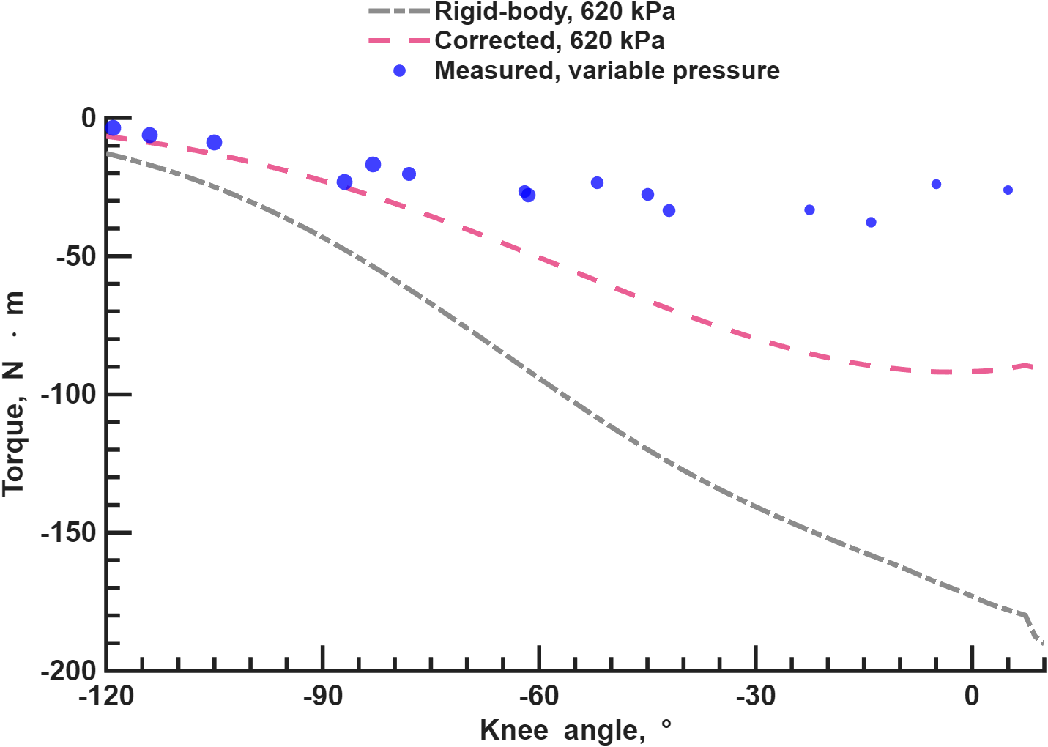
ROUTE REDESIGN: REMAINING UNCERTAINTY
The corrected 620 kPa prediction still exceeds many measured flexor torques
Fixed-pressure curves; variable-pressure measurements
Knee-torque paper · Fig. Flx20mm, panel B; unchanged MATLAB calculation
20
Notes:
1 minute. Rigid prediction peak magnitude 190.3 N·m and corrected prediction 91.9 N·m are at 620 kPa. Measurements use different pressures, so this plot establishes neither a matched-pressure residual nor universal accuracy. The corrections substantially change the design prediction, but remaining mismatch motivates controlled matched-pressure tests and better transmission modeling. Distinguish the demonstrated capacity from validated accuracy of the full predicted curve.
Sources: Knee-torque paper · Fig. Flx20mm, panel B; unchanged MATLAB calculation

Slide 21

SENSORY AFFERENT DATABASE: GAP AND CONTRIBUTION
SADb links sensory-feedback literature to inspectable source records
Revision C · Ch. 5, The Resource; SADb application snapshot
21
Notes:
1 minute. Gap: controller-design evidence is dispersed across species, preparations, tasks, and papers. I curate linked paper, pathway, model, review, and recorder records and build the read-only browser application. Latest distributed snapshot: 1,393 total records, including 943 papers and 450 other linked records. This is a curated research collection, not a systematic review. Offline embedded data support searching, pivoting, and citation exploration; the separate online-search tab requires connectivity. The existing screenshot illustrates the application, not a benchmark of retrieval accuracy.
Sources: Revision C · Ch. 5, The Resource; SADb application snapshot

Slide 22

SENSORY AFFERENT DATABASE: USE AND LIMITS
SADb exposes classification coverage without supplying controller gains
Tagged papers retain their experimental context
Revision C · Ch. 5, Fig. sadb_pivot and Use in Neural-Controller Design
22
Notes:
1 minute. A pivot cell counts tagged papers, not neurons or independent physiological observations. A paper can appear in more than one cell. Selecting a cell retrieves the underlying records. Afferent classes Ia, Ib, and II denote spindle-primary, tendon-organ, and spindle-secondary channels. Their properties depend on preparation and task. Source conditions, sign, and phase guide interpretation; translating them into robot encoders and gains remains an explicit design and verification step. AI-assisted drafting does not count as scientific curation without source checking. The corpus is uneven and not exhaustively classified.
Sources: Revision C · Ch. 5, Fig. sadb_pivot and Use in Neural-Controller Design

Slide 23
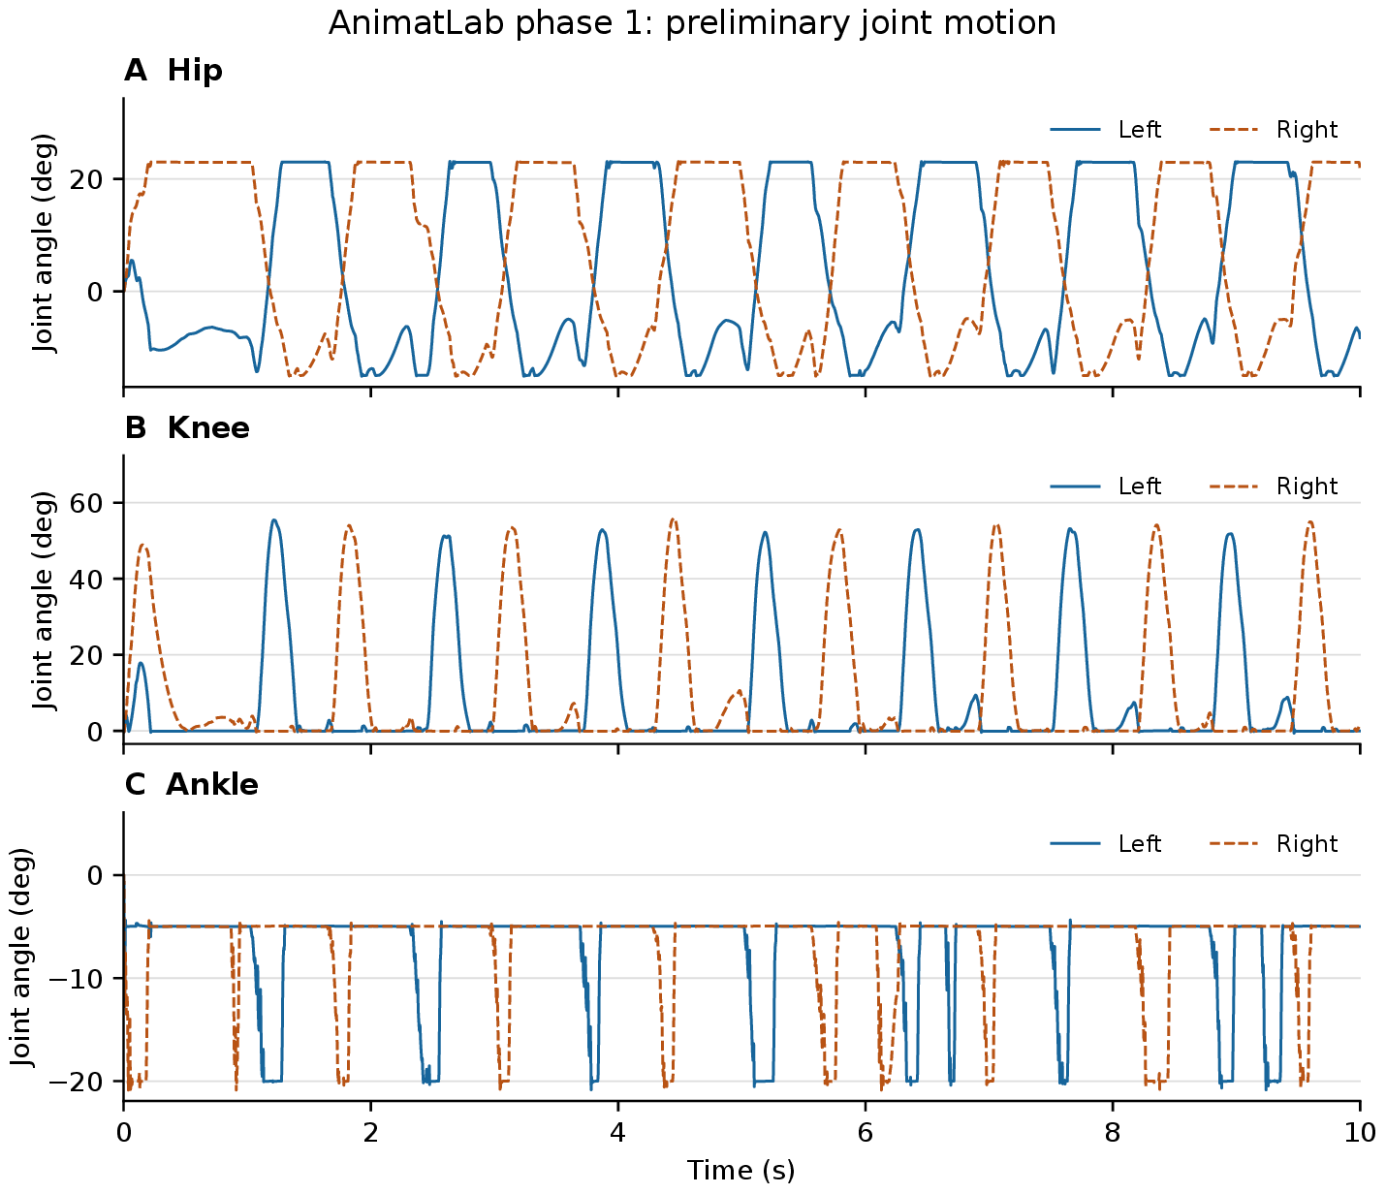
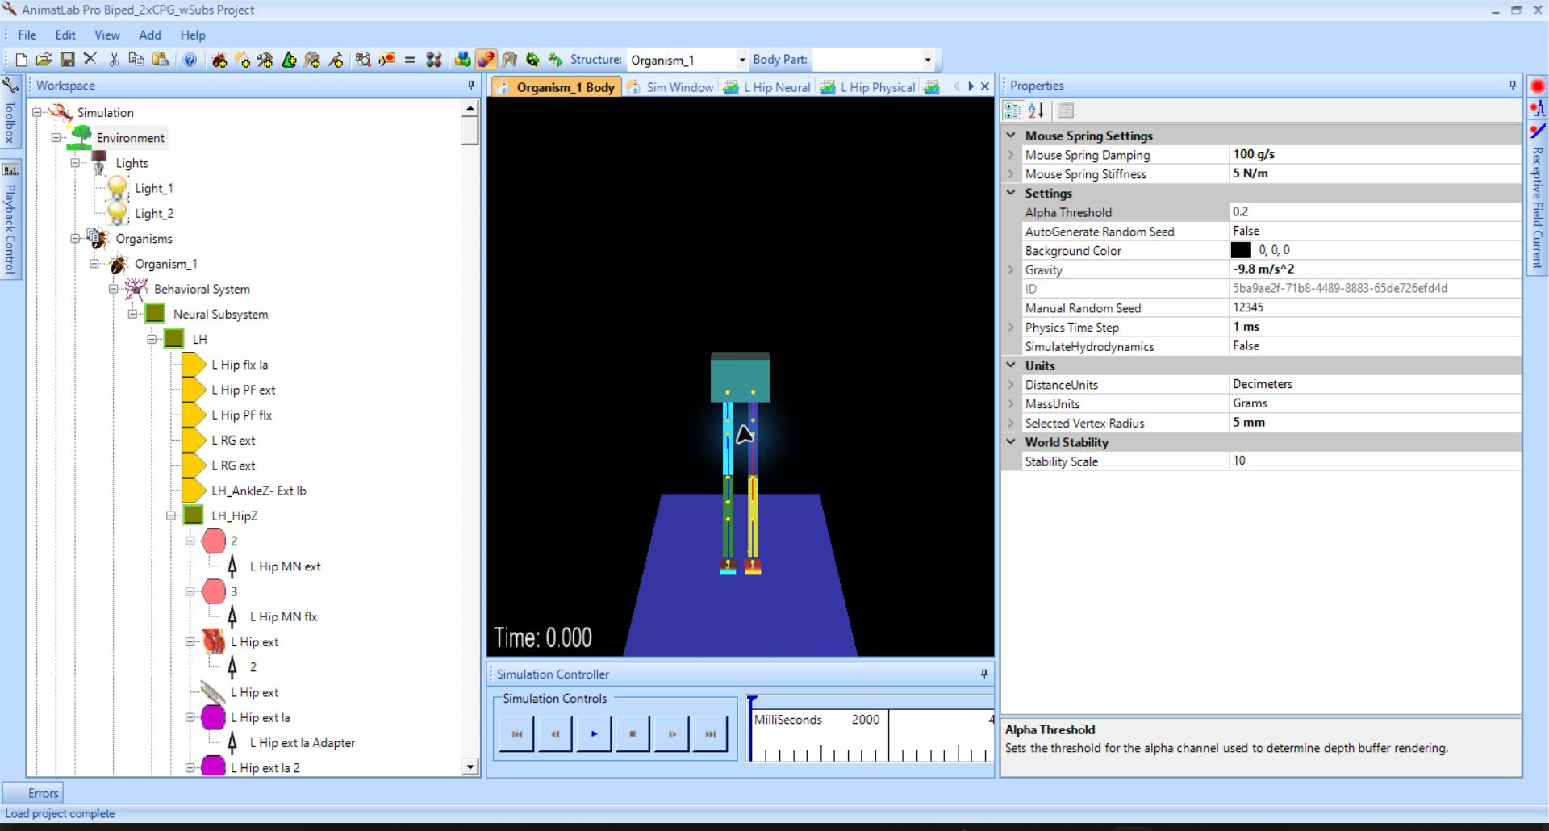
NEURAL SIMULATION: MOTIVATING LIMITATION
The initial one-RG AnimatLab model produced suspended stepping
Initial mechanics and controller integration
Suspended joint motion
Revision C · Ch. 6, The AnimatLab Bipedal Walker; Li (2017), Deng (2019), Bolen (2021)
23
Notes:
1 minute. Morrow and I combined Li’s mechanics with Deng’s two-level controller. The initial controller had ONE rhythm generator controlling both sides and a separate pattern-formation layer. I added a passive toe joint. Suspended alternating activity and stepping-like movement preceded subsequent feedback and bilateral-RG extensions. Hand tuning did not achieve weight-bearing walking. Do not attribute this earlier result to the later two-RG network. These phase-1 angle traces are historical, suspended evidence.
Sources: Revision C · Ch. 6, The AnimatLab Bipedal Walker; Li (2017), Deng (2019), Bolen (2021)

Slide 24
NEURAL SIMULATION: DISTINCT CONTRIBUTION
I later extended the controller into interconnected left and right RGs
Left rhythm generator
Right rhythm generator
Commissural pathways
Left pattern formation
Right pattern formation
Conceptual architecture; walking remains unverified
Revision C · Ch. 6, The AnimatLab Bipedal Walker
24
Notes:
45 seconds. RG means rhythm generator. This editable conceptual schematic summarizes the documented bilateral architecture, not the full connectome. I constructed right-side subsystems from the left organization and connected the two RGs through commissural pathways. No walking result follows from assembly alone. The initial suspended stepping preceded this extension. Published Deng architecture underlies the controller; the bilateral extension is my contribution.
Sources: Revision C · Ch. 6, The AnimatLab Bipedal Walker

Slide 25

NEURAL SIMULATION: TOOL CONTRIBUTION
My interfaces connect existing mechanics and neural formulations
Repaired and audited model coupling
Editable implementations of existing equations
Revision C · Ch. 6, Model Conversion and Graphical Circuit Construction
25
Notes:
1 minute. OpenSim and MyoConverter supply geometry and initial conversion; MuJoCo supplies physics; SNS-Toolbox supplies conductance-based neural equations. My additions repair and audit custom muscle paths and joint signs, couple the quasi-static BPA-force model, and implement editable Simulink blocks and circuit interfaces. Neural and mechanical models exchange signals every 2 ms. There is no new neuron formulation or demonstrated integrated valve dynamics. Mechanical imports remain distinct from standalone reflex demonstrations. No Hunt/Young library comparison or speed superiority is claimed.
Sources: Revision C · Ch. 6, Model Conversion and Graphical Circuit Construction

Slide 26

NEURAL SIMULATION: REPRESENTATIVE CIRCUIT
The graphical library implements defined Ia and Ib reflex pathways
Reduced-order demonstration; provisional mechanical parameters
Revision C · Ch. 6, Fig. simulink_reflex_topology
26
Notes:
1 minute. Reduced-order antagonist knee model. Ia spindle excitation drives its homonymous motor pool and reciprocal inhibition of the antagonist. Ib tendon-organ input inhibits the homonymous pool in this demonstration. These are chosen circuit rules, not a universal claim about Ib function. Mechanical parameters and generic BPA-block parameters remain provisional. In the separate beverage-arm demonstration, reflex enabled sag was 2.00 degrees versus 7.85 degrees disabled. That reduced model does not establish reflex control of imported full-body mechanisms.
Sources: Revision C · Ch. 6, Fig. simulink_reflex_topology

Slide 27

NEURAL SIMULATION: MATCHED VERIFICATION
Matched rhythm-core implementations reproduce the same driven bursts
1.000 s periods; trace correlation ≥ 0.99996
Revision C · Ch. 6, Fig. w2l_crossengine; matched NumPy and Simulink protocol
27
Notes:
1.5 minutes. The contact-driven W2L rhythm-core test receives matched inputs. Ten expected bursts appear, burst period 1.000 s, full-trace correlation at least 0.99996, with a residual 2 ms lag of one solver step. Removing phasic heel-contact inputs makes both realizations latch. This agreement is scoped to the circuit and protocol. It is neither autonomous oscillation proof nor walking verification. The separate 92-actuator tonic-drive test has a discrepancy and follows next.
Sources: Revision C · Ch. 6, Fig. w2l_crossengine; matched NumPy and Simulink protocol

Slide 28
NEURAL SIMULATION: VERIFICATION BOUNDARY
The bridge exchanges signals while full-network dynamics still disagree
Verification level | Observed result
Sensor and command exchange | Bit-exact scored readback
92-actuator closed-loop run | Signals exchanged for 5 seconds
Full network under tonic drive | Simulink settles; NumPy oscillates
Interface correctness and controller equivalence need separate tests
Revision C · Ch. 6, Closed-Loop Model Coupling and capability table
28
Notes:
1 minute. The bridge was checked against independent Python integration with single-muscle activation, different control rates, and sensor readback. Readback is bit-exact over the scored window. The exported neural network drove all 92 actuators for 5 seconds. However, tonic drive caused the Simulink realization to settle while the NumPy reference oscillated. Transfer of tuned controller parameters remains unresolved. Do not generalize the rhythm-core agreement to the full network. Hardware deployment and unsupported walking remain future work.
Sources: Revision C · Ch. 6, Closed-Loop Model Coupling and capability table

Slide 29
CONCLUSIONS
The evidence supports static torque capacity and specific simulation interfaces
Contribution | Evidence | Boundary
Actuator force model | Measured force and held-out fits | Static, tested actuator range
Joint model and routes | Held-out error and physical holds | Variable pressure; residual mismatch
SADb | Inspectable linked records | Uneven source coverage
Neural interfaces | Matched tests and signal readback | Full-network discrepancy; no free walking
Revision C · Chs. 3–7; final flexor MATLAB reduction, 23 October 2026
29
Notes:
1 minute. Return to the four original gaps. Force: supported by characterized lengths and isometric data. Torque: identified corrections improve held-out predictions and redesigned routes have physical tests. Sensory evidence: searchable, linked, partially curated literature resource. Neural tools: matched circuit and interface checks, with explicit full-network discrepancy. Neither static isometric capacity nor supported stepping demonstrates a walking robot. No harness-free walking exists in the program records.
Sources: Revision C · Chs. 3–7; final flexor MATLAB reduction, 23 October 2026

Slide 30

NEXT EXPERIMENTS
Matched-pressure tests and controller reconciliation are the next checks
Close the measured gaps before transferring control to hardware
Revision C · Ch. 7; Ch. 6, remaining limits
30
Notes:
45 seconds. The next experiments address the uncertainty exposed by the results: matched-pressure torque holds over the range, and diagnosing numerical/network differences before transferring tuned control. The dashed hardware path in this existing pipeline is proposed. Do not present a Jetson deployment, completed valve dynamics, or whole-body walking as achieved. Physical pulley tests and simultaneous biarticular verification are future work.
Sources: Revision C · Ch. 7; Ch. 6, remaining limits

Slide 31
ACKNOWLEDGMENTS
Questions
Thank you
Advisor: M. Anthony Hunt
Committee, AARL, and research collaborators
Ben P. Bolen · Mechanical Engineering · Portland State University
31
Notes:
Thank the advisor M. Anthony Hunt, the committee, the AARL, and the dissertation collaborators. Recognize M. Elzein, L. Pang, L. Burgess, C. Morrow, J. Scharzenberger, C. Steele, and J. Chung. This slide ends the main presentation. Hidden backup follows.
Sources: Ben P. Bolen · Mechanical Engineering · Portland State University

Slide 32
BACKUP: ACTUATOR EQUATION
The force model combines normalized force with resting-length scaling
Separate coefficients apply to each diameter
Revision C · Ch. 3, force equation; Bolen et al. (2026)
32
Notes:
Define epsilon as contraction, P as pressure, l0 as resting length. Diameter-specific coefficients enter normalized force and maximum-force scaling. Maximum contraction is measured for each actuator. This model is quasi-static; neither valve dynamics nor hysteresis are included.
Sources: Revision C · Ch. 3, force equation; Bolen et al. (2026)

Slide 33

BACKUP: TRANSFER TO BIOMIMETIC KNEE
Earlier biomimetic-extensor measurements retain residual prediction error
Earlier 10 mm configuration
Revision C · Ch. 4, Fig. Ext10mm_52cm; see adopted shared-pair table for final statistics
33
Notes:
This is the earlier 10 mm, 51.8 cm configuration, not the new two-20 mm cam route. Do not mix earlier standalone fits with final shared-pair statistics. Revision C prose retains conflicting earlier 0.8920 RMSE and later adopted-pair 1.17 RMSE descriptions. The latter is explicitly the shared-pair comparison. Resolve the analysis scope before quoting either as a universal final fit.
Sources: Revision C · Ch. 4, Fig. Ext10mm_52cm; see adopted shared-pair table for final statistics

Slide 34

BACKUP: ROUTE EXTENSION
Pulley transmission predictions still require physical verification
Model predictions; adjacent joint fixed in biarticular planes
Revision C · Ch. 4, Mono- and Bi-Pulley Tendon Routing
34
Notes:
These surfaces are optimizer predictions, not physical measurements. Parallel actuator number and tackle line parts alter force/travel tradeoffs. Biarticular evaluation fixes the adjacent joint, so it does not establish simultaneous performance across both joints. Different route objective values are not directly comparable. Ongoing transmission studies are not finished hardware results.
Sources: Revision C · Ch. 4, Mono- and Bi-Pulley Tendon Routing

Slide 35

BACKUP: SIMULATION SCOPE
Supported actuator-driven motion provides a coupling test
Mechanical support remains
Revision C · Ch. 6 and Appendix, Simulation Verification
35
Notes:
Historical representative BPA-actuated run, retained-support/air-stepping scope. Neural output drives actuator forces and mechanical signals return to the controller. No harness-free walking. Do not use frozen or NaN runs as walking, and do not infer current tuned performance from a legacy score. Later wean studies reduce tonic drive, not mechanical support.
Sources: Revision C · Ch. 6 and Appendix, Simulation Verification

Slide 36

BACKUP: NEURAL CODING
Spiking and non-spiking realizations can produce different timing
A matched interface does not ensure matched dynamics
Revision C · Appendix, Simulation Verification; knee spiking-twin figure
36
Notes:
Representative reduced knee demonstration. Continuous motor activation interface is retained while the neural coding changes. This comparison is specific to selected parameters. It does not establish superiority, biological fidelity, full-network equivalence, or successful parameter transfer. Generic mechanical parameters remain provisional.
Sources: Revision C · Appendix, Simulation Verification; knee spiking-twin figure

Slide 37
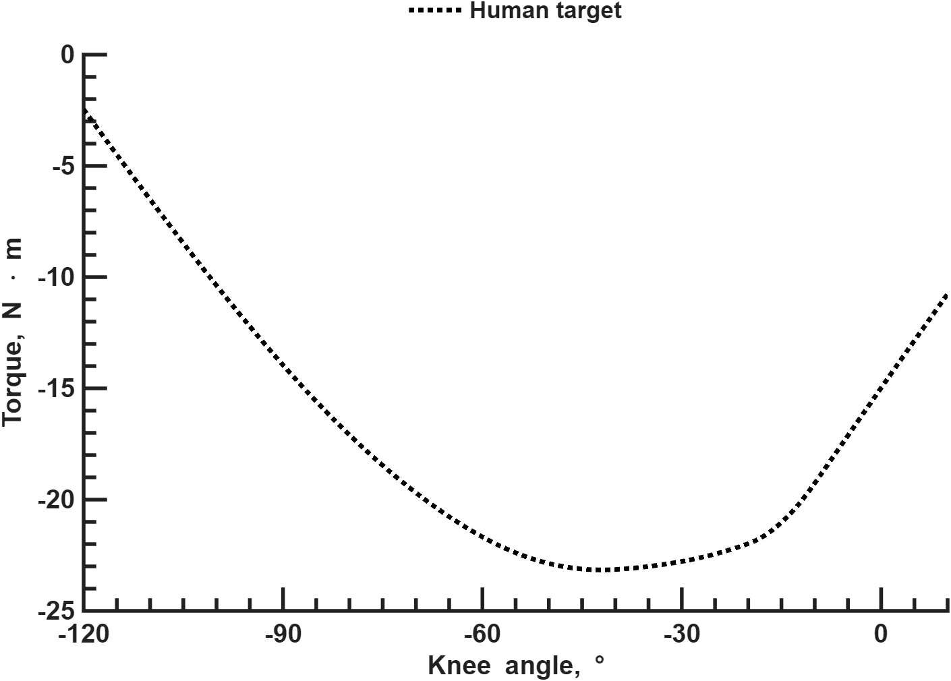
BACKUP: TARGET DEFINITION
The human comparison uses one selected muscle reference
Biceps femoris short head; maximum isometric model torque
Knee-torque paper · Fig. Flx20mm, panel A; OpenSim Gait2392
37
Notes:
Maximum-isometric biceps femoris short-head target, negative flexion torque. This is one modeled monoarticular muscle, not total voluntary human knee torque, a patient outcome, or an experimentally measured person. Extensor optimization uses its separately defined selected vastus reference.
Sources: Knee-torque paper · Fig. Flx20mm, panel A; OpenSim Gait2392

